Slide 1
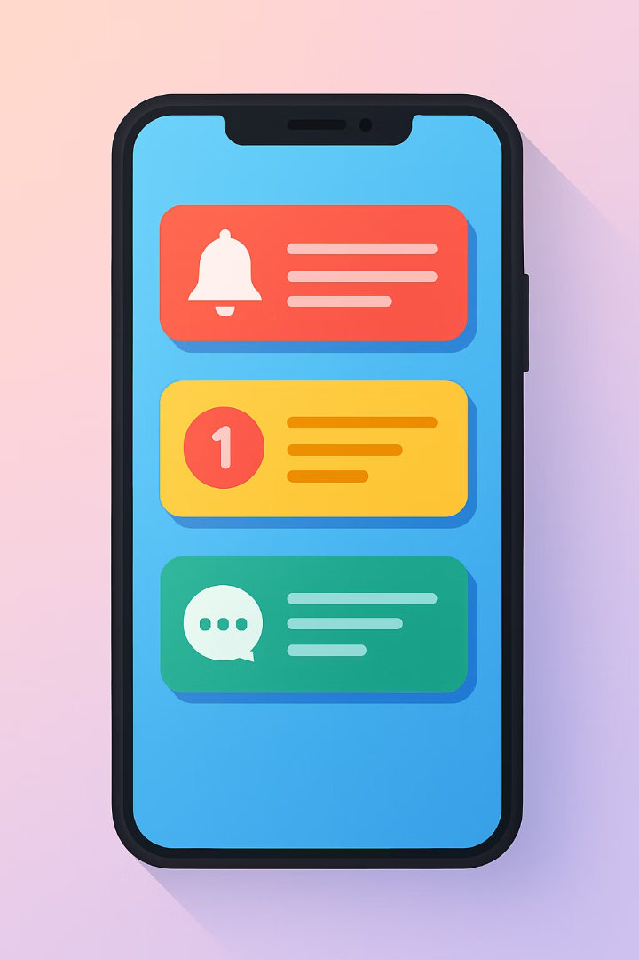
Mastering Notifications in Expo Apps
Notifications are an essential mobile app feature used by 72% of users. They can increase user engagement by up to 88%.
This tutorial shows how to implement notifications in Expo without external dependencies.

Slide 2





Understanding Notifications in Expo
Local Notifications
Push Notifications
Triggered within your app without server involvement
Sent from remote servers to reach users anytime
Unified API
Cross-Platform
Expo provides one interface for both notification types
Works on iOS, Android, and web platforms

Slide 3

Setting Up Your Environment
Create Notification Service
Update app.json Configuration
Create a notificationService.js file to centralize notification logic including permission handling, scheduling, and listening for responses
Install Required Packages
Add the notification object to configure Android channels and iOS categories:
Run expo install expo-notifications expo-device in your terminal to add the necessary packages to your project
{
"expo": {
"plugins": [
[
"expo-notifications",
{
"icon": "./assets/notification-icon.png",
"color": "#ffffff"
}
]
]
}
}

Slide 4
Notification Permissions
iOS Requirements
Android Approach
iOS 10+ requires explicit user permission via UNUserNotificationCenter
Android 13+ requires explicit permission for POST_NOTIFICATIONS
Request permissions with a code snippet like:
Android 8+ uses notification channels that users can toggle individually
await Notifications.requestPermissionsAsync({
ios: {
allowAlert: true,
allowBadge: true,
allowSound: true
}
});
Create channels with:
await Notifications.setNotificationChannelAsync('default', {
name: 'Default',
importance: Notifications.AndroidImportance.HIGH,
vibrationPattern: [0, 250, 250, 250]
});
If rejected, direct users to Settings app - permissions cannot be re-prompted programmatically

Slide 5
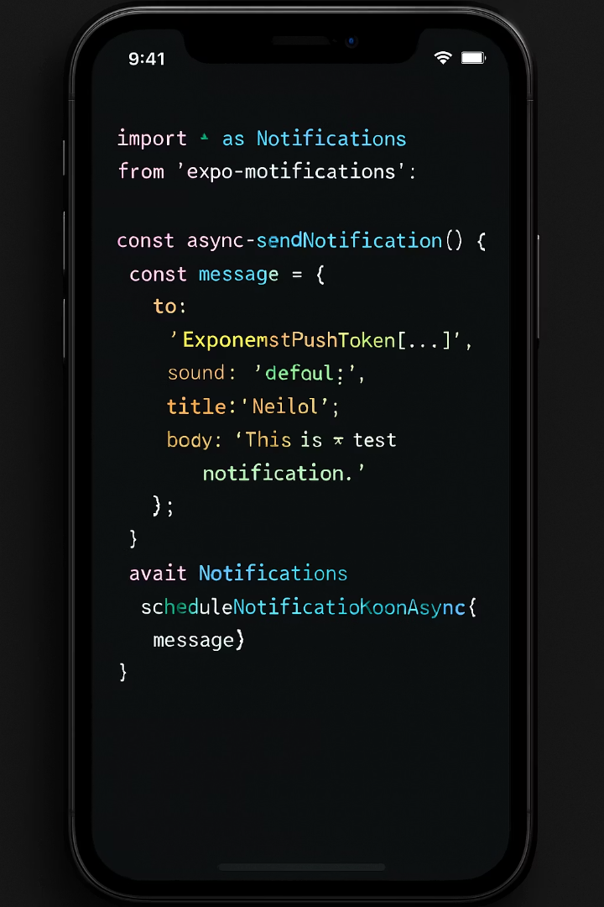

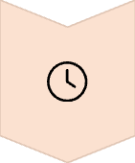


Local Notifications: Implementation
Create Content
Define title, body, data, and sound options
Set Trigger
Choose immediate, delayed, or scheduled timing
Schedule Notification
Call scheduleNotificationAsync with content and trigger
Handle Response
Store the notification identifier for later management

Slide 6
Local Notifications: Implementation
import React, { useEffect } from 'react'; import { Button, View, StyleSheet, Platform, Alert } from 'react-native'; import * as Notifications from 'expo-notifications'; // Set the notification handler Notifications.setNotificationHandler({ handleNotification: async () => ({ shouldShowAlert: true, shouldPlaySound: false, shouldSetBadge: false, }), }); const scheduleNotification = async () => { await Notifications.scheduleNotificationAsync({ content: { title: 'Local Notification', body: 'This notification was scheduled 5 seconds ago.', }, trigger: { seconds: 5 }, }); };
export default function App() {
useEffect(() => {
registerForPushNotificationsAsync();
}, []);
const registerForPushNotificationsAsync = async () => {
const { status } = await Notifications.requestPermissionsAsync();
if (status !== 'granted') {
Alert.alert('Permission not granted for notifications.');
}
};
return (
<View style={styles.container}>
<Button title="Send Local Notification" onPress={scheduleNotification} />
</View>
);
}
const styles = StyleSheet.create({
container: {
flex: 1,
justifyContent: 'center',
paddingHorizontal: 20,
},
});

Slide 7
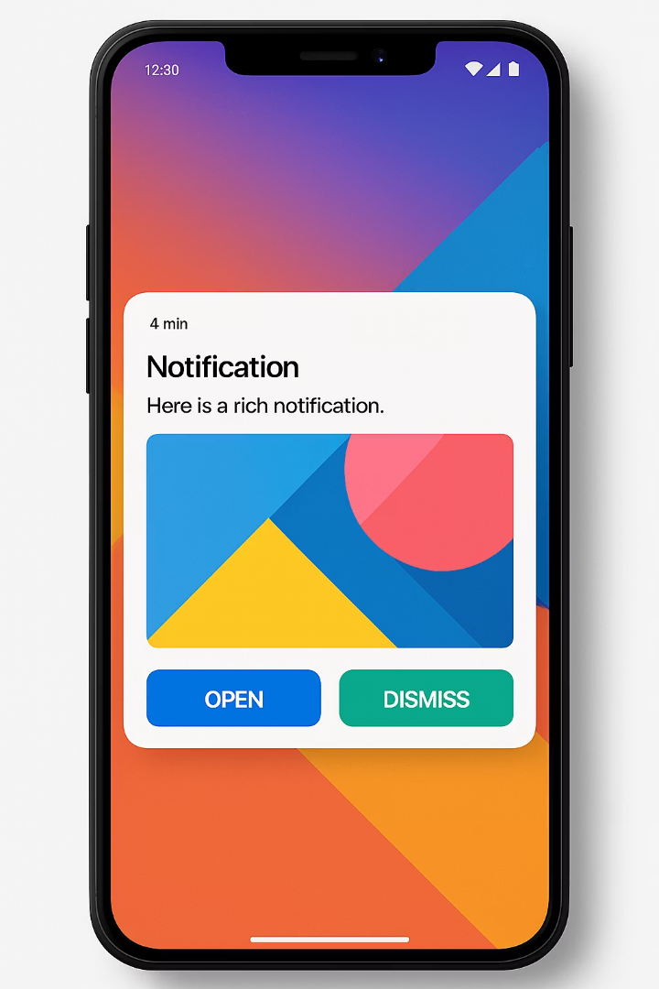
Advanced Local Notification Features
Rich Media Notifications
Add images to make notifications more engaging
Support varies by platform but Expo handles differences
Repeating Notifications
Schedule daily reminders or periodic updates
Use calendar or interval-based triggers
Custom Actions
Add buttons for quick responses
Enable direct interaction without opening the app
Deep Linking
Navigate users to specific screens when tapped
Pass relevant data through notification payload

Slide 8



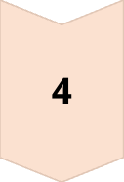
Handling Notification Interactions
Properly handling notification interactions is crucial for a seamless user experience. Expo provides different tools depending on the app state.
Foreground Notifications
When app is open and visible, use Notifications.addNotificationReceivedListener() to capture and handle incoming notifications while users are actively using your app.
Background Notifications
When app is running but not in focus, implement Notifications.setNotificationHandler() with custom behavior to control how notifications appear.
Killed State Handling
When app is completely closed, configure experienceId in app.json to ensure your app can be launched by notification taps.
User Response
Capture tap actions with useLastNotificationResponse() hook to retrieve payload data and navigate users to appropriate screens.

Slide 9
Handling Notification Interactions example
import React, { useEffect, useRef } from 'react';
import { Button, View, Text, Alert, StyleSheet } from 'react-native';
import { NavigationContainer } from '@react-navigation/native';
import { createStackNavigator } from '@react-navigation/stack';
import * as Notifications from 'expo-notifications';
// Set foreground behavior (alert, sound, badge)
Notifications.setNotificationHandler({
handleNotification: async () => ({
shouldShowAlert: true,
shouldPlaySound: true,
shouldSetBadge: false,
}),
});
const styles = StyleSheet.create({
container: {
flex: 1,
justifyContent: 'center',
alignItems: 'center',
paddingHorizontal: 20,
},
title: {
fontSize: 24,
marginBottom: 20,
},
});
const Stack = createStackNavigator();
const ProfileScreen = ({ route }) => {
const { userId } = route.params || {};
return (
<View style={styles.container}>
<Text style={styles.title}>User Profile</Text>
<Text>User ID: {userId}</Text>
</View>
);
};
export default function App() {
return (
<NavigationContainer>
<Stack.Navigator>
<Stack.Screen name="Home" component={HomeScreen} />
<Stack.Screen name="Profile" component={ProfileScreen} />
</Stack.Navigator>
</NavigationContainer>
);
}

Slide 10
const HomeScreen = ({ navigation }) => { const notificationListener = useRef(); const responseListener = useRef(); useEffect(() => { // Listen for notifications when app is in foreground notificationListener.current = Notifications.addNotificationReceivedListener(notification => { console.log(' Notification received in foreground:', notification); }); // Handle tap on notification responseListener.current = Notifications.addNotificationResponseReceivedListener(response => { const data = response.notification.request.content.data; console.log(' Notification tapped with data:', data); if (data?.screen) { navigation.navigate(data.screen, { userId: data.userId }); } }); return () => { // Cleanup listeners Notifications.removeNotificationSubscription(notificationListener.current); Notifications.removeNotificationSubscription(responseListener.current); }; }, []);
const scheduleNotification = async () => {
await Notifications.scheduleNotificationAsync({
content: {
title: 'Navigate to Profile',
body: 'Tap to view user profile',
data: { screen: 'Profile', userId: 123 }, // navigation data
},
trigger: { seconds: 5 },
});
};
return (
<View style={styles.container}>
<Text style={styles.title}>Home Screen</Text>
<Button title="Schedule Notification" onPress={scheduleNotification} />
</View>
);
};
This example demonstrates a complete implementation of notification interaction handling, including:
Setting up a background notification handler
Listening for foreground notifications with addNotificationReceivedListener
Capturing user taps on notifications with addNotificationResponseReceivedListener
Processing notification data for navigation
Proper cleanup of listeners to prevent memory leaks

Slide 11

Debugging Notifications
Issue
Troubleshooting Step
Notifications not appearing
Check permissions and notification channels
Delayed notifications
Verify trigger timing and battery optimization settings
Missing content
Log notification payloads to check structure
Platform differences
Test on actual devices, not just simulators

Slide 12



Real-World Implementation Example
Notification Manager
Create a central service to handle all notification logic
User Preferences
Allow users to customize notification categories and timing
Analytics Integration
Track open rates to optimize notification strategy

Slide 13
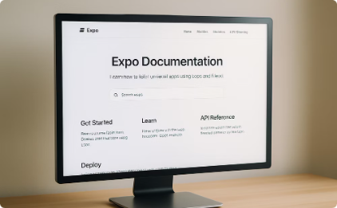
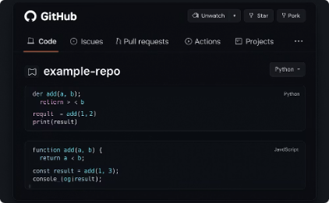
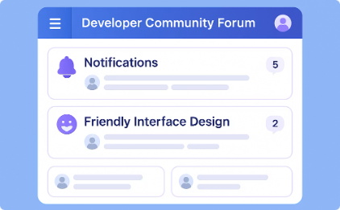
Next Steps and Resources
Official Documentation
Comprehensive guides for all notification features
Sample Repositories
Complete code examples for reference implementations
Community Support
Get help with complex notification scenarios

Slide 14








Summary: Key Takeaways
Implement Today
You now have all tools to add notifications to your app
Explore Advanced Features
Rich media, actions, and scheduled notifications
Respect User Preferences
Balance engagement with user experience
Start Simple
Begin with local notifications before adding push

